Slide 1


Pritesh Pinakinbhai Rami
Hardip Ravalji
Prepared By
Guided By
Shri D N I C A
Submitted To
.
V. V. Nagar - 288120
Notes:
AMCOST, Anand.

Slide 2

Project Profile
Introduction
Scope of work
Objectives
Proposed System
System Specification
Data Flow Diagram
Database Layout
Design Layout
Limitations
Conclusion
Bibliography
Notes:
AMCOST, Anand.

Slide 3

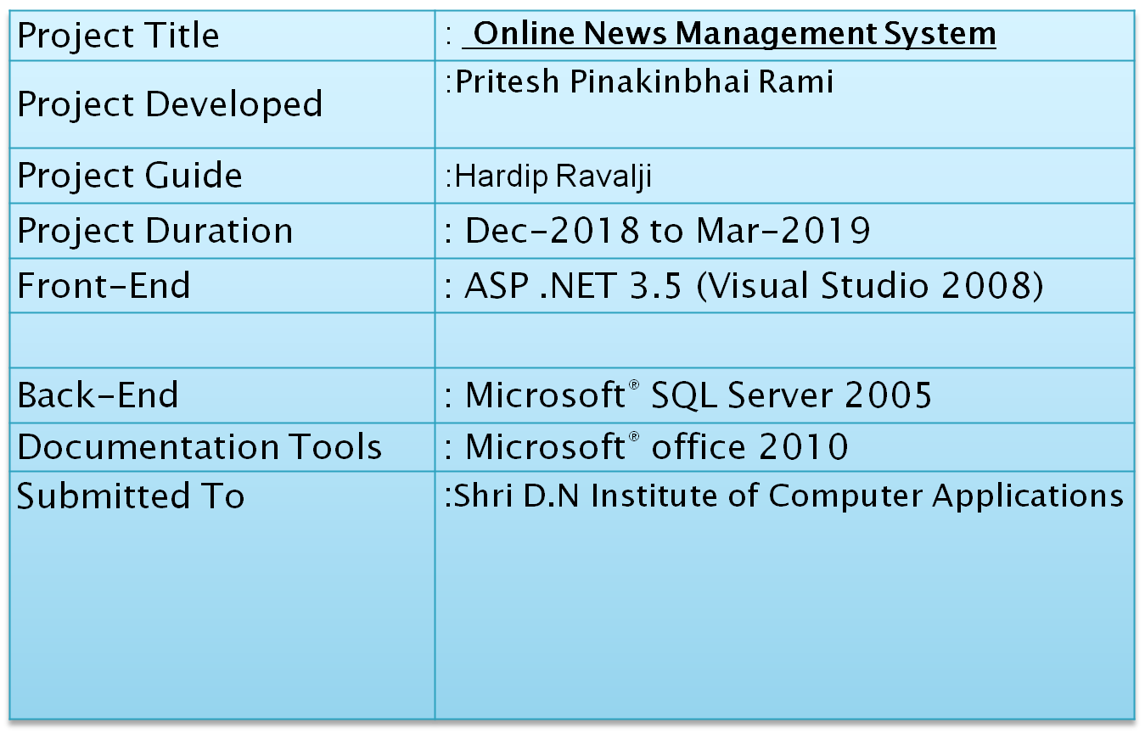

Slide 4

The Theme of my project is Online News Management System.
Now-a-days we live in age of Information Communication and Technology (ICT). We can’t think a single moment without technology. From morning to night, we need help of the technology. This is the revolutionary time of computer technology. Most of the works depends on web application. For this reason, anytime, anywhere, anyone can access a website by internet at low cost and we can find our expectable and most update information from website. At present information is one the most valuable resource of the current world. We have developed our project so that we can aware the people.
Notes:
AMCOST, Anand.

Slide 5

The objective of this project is to develop a web application for Online News.
Online website that can aware the people.
The objective of this project is to provide the daily news.
The objective of this project is to provide the breaking news.
It makes use of various technologies to get required crime oriented information more quickly, easily, colorfully and attractively.
To do this for more widely coverage of distribution and faster dissemination of information in a more timely manner.
Anytime, anywhere, anyone can know about the news or information by internet at low cost. Dynamically provides facility.
To add any new information without any complexity.

Slide 6

Manually work has to be reduce
To speed up the operation.
Reduce paper work.
Get accuracy
To provide full detail
To reduce birder register of making it computerize through by online
To provide data security in such a way that there is no chances of misplacement or loss of information.
Increase security , speed storing and accuracy
User can open medium through network internet you can anyplace internet open you can information data, reports, receive any place.
Notes:
AMCOST, Anand.

Slide 7

The purpose of the whole system is to ease the daily or regular news and activities into an automatic computerized retrievable process. The daily activities include the politics, Entering sports, science and technology, updating of news and to record the process in a Computer system for future.
Due to time constraint and the minimum resources the system is not made for the high level use. But the management system can use the application n very easy and minimum effort.

Slide 8
Tables
Table name: User
Col_name | DataType | size | key | Descrption
Uname | varchar | 50 | Primary | Username
Pwd | varchar | 50 | - | Password
Mail | varchar | 50 | - | Email id
contact | Numeric | 12 | - | Phone No

Slide 9

Table name: News
Col_name | DataType | size | key | Descrption
NID | varchar | (30) | Primary | News Id
Type | varchar | (50) | - | News type
yr | numeric | - | - | News year
News | varchar | (MAX) | - | News description

Slide 10

Table name: Feedback
Col_name | DataType | size | key | Descrption
Uname | varchar | (30) | Primary | Username
Msg | varchar | (100) | - | Comment or Message

Slide 11

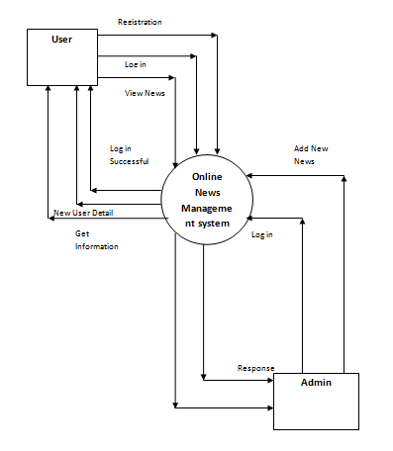
Context Level:

Slide 12
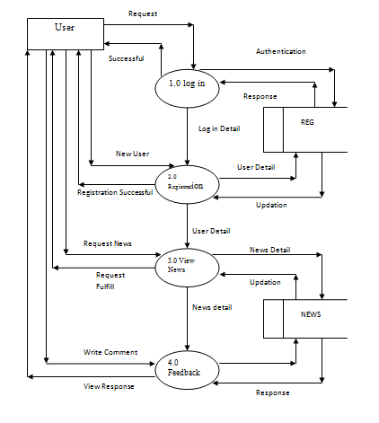
Zero Level Diagram for User:

Slide 13
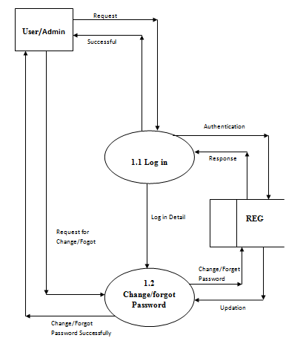
First Level for Login:

Slide 14
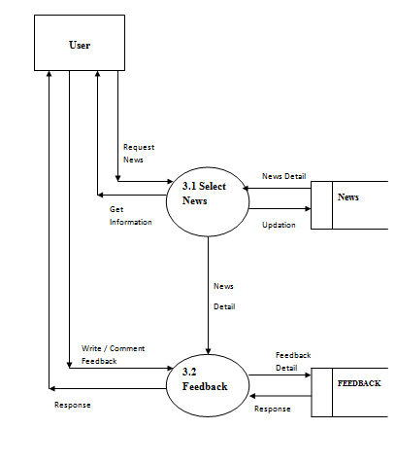
First Level for News:

Slide 15

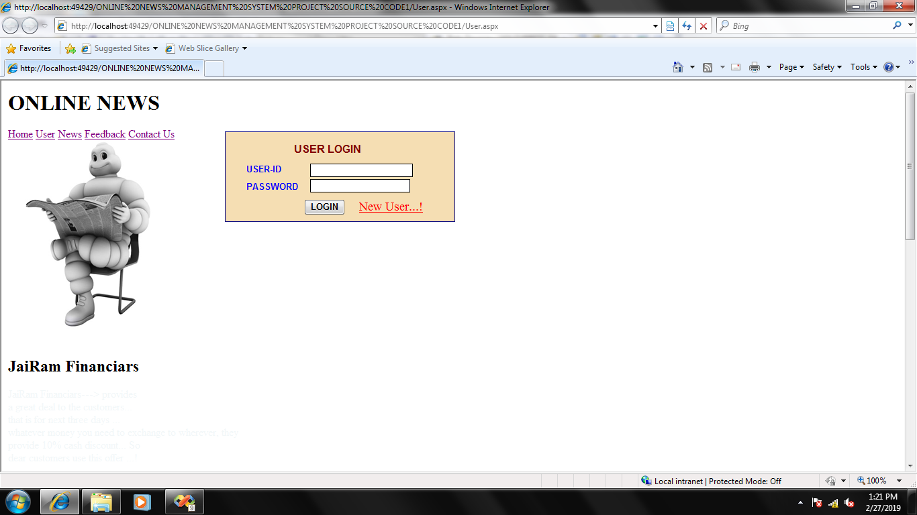

Slide 16

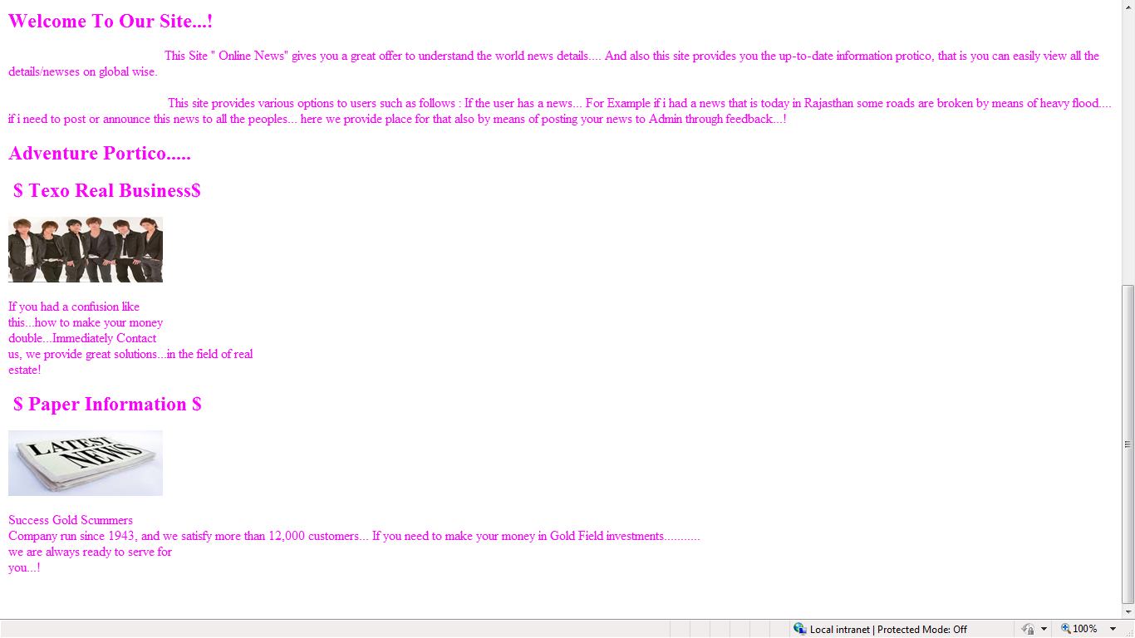

Slide 17
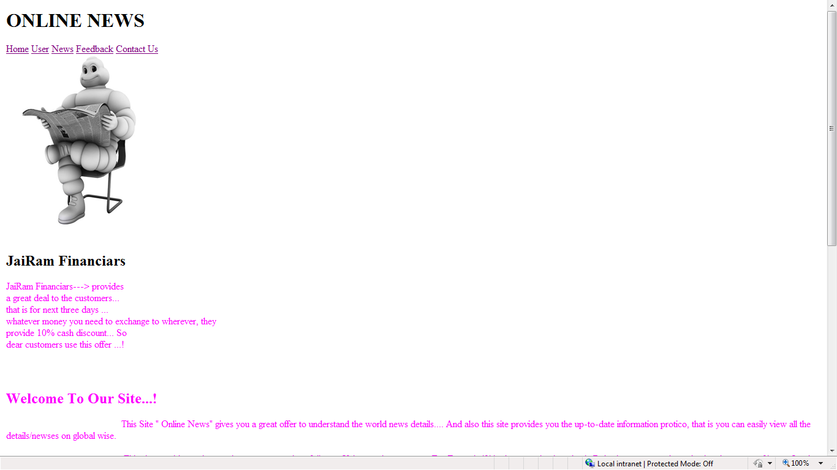

Slide 18
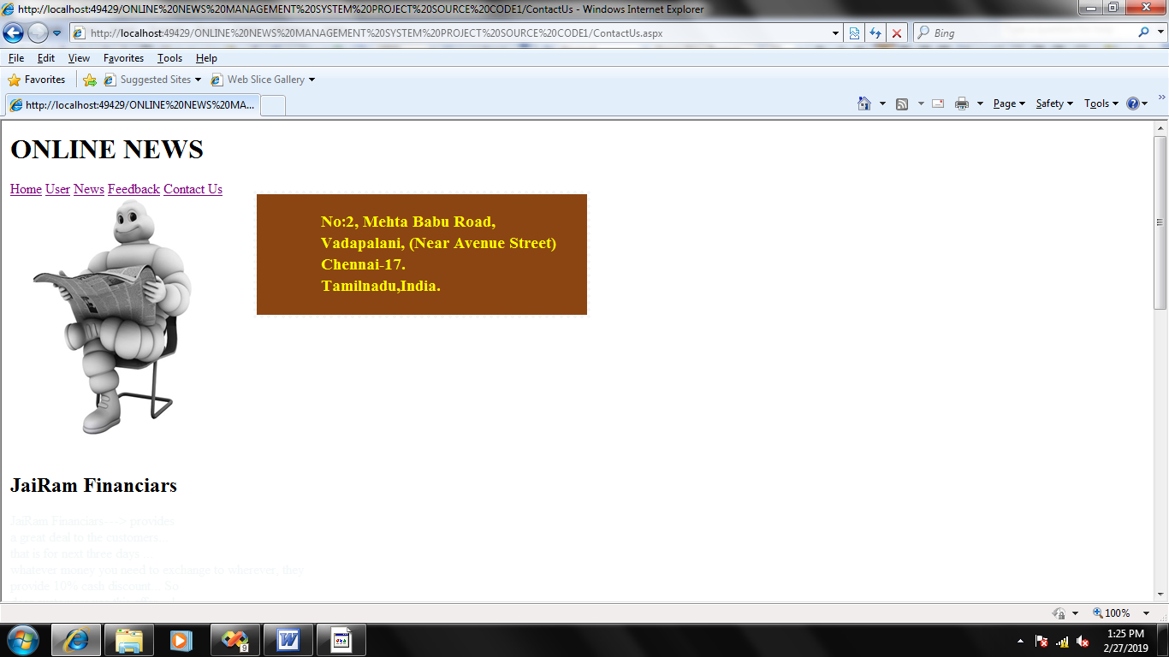

Slide 19
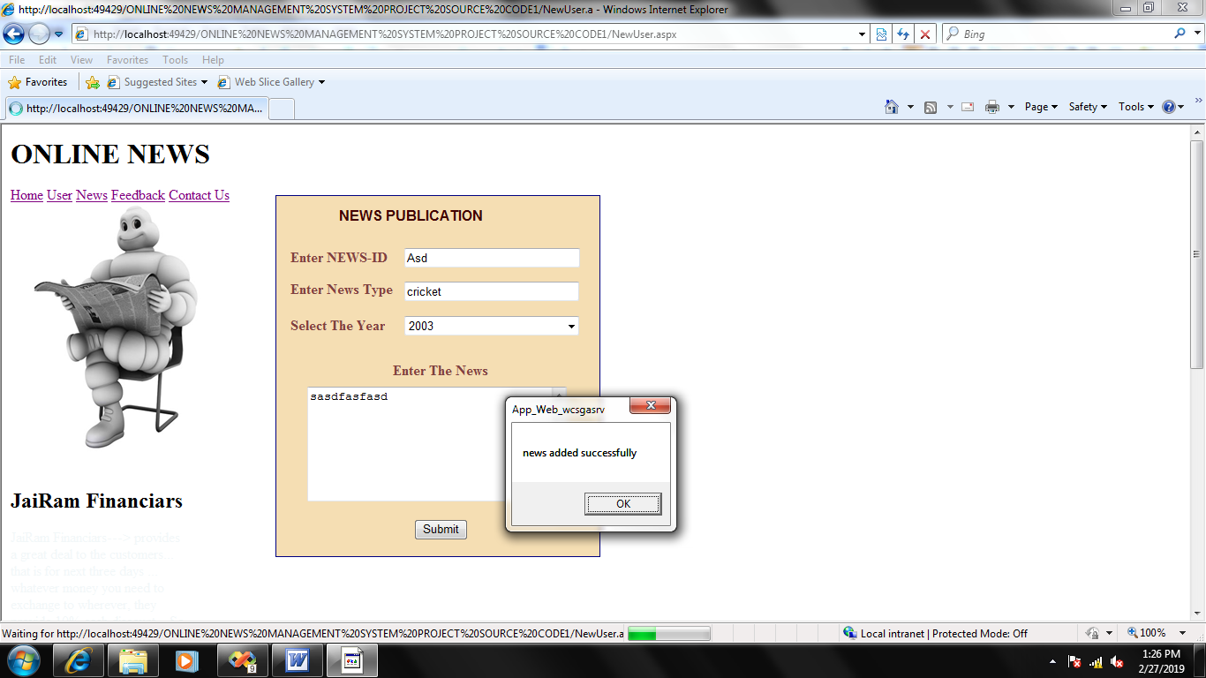

Slide 20

More human power
More strength and strain of manual labour needed
Repetition of same procedure.
Low security.
Data redundancy.
Difficulty to handle.
Difficulty to update data.
Record keeping is difficult.
Backup data can be easily generated.

Slide 21

It was a really good experience for us to do a project. Working on this project has given us a valuable experience. It has been like stepping on the first step of the staircase that leads us towards building our career. It was our first experience of working in the atmosphere of a software firm.
At the time of practically executing our knowledge, we fortunate to have very cooperative and supportive project leaders and colleagues, their attitude towards us was very palliative and was always there in our needs.
We also learnt have to college with other lecturers while working in the same project. This precious experience would definitely be helpful to us for future.
We like this opportunity to convey our special thanks to all those who played role in making this project a success and a great learning experience for us.

Slide 22

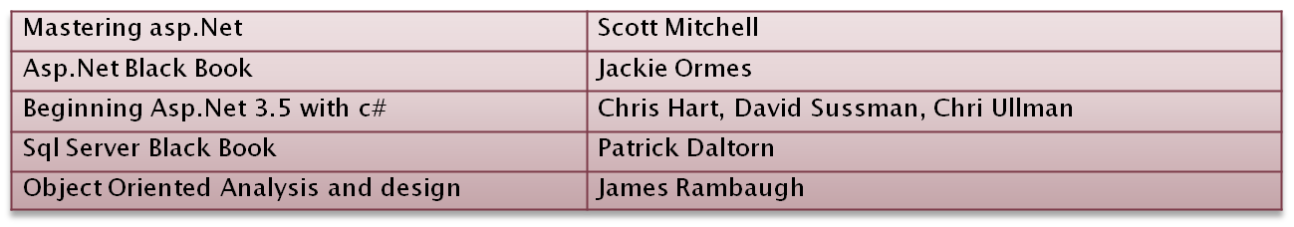
Books
Web References
www.google.com
www.msdn.microsoft.com
www.w3schools.com
www.wikipedia.org

Slide 23


